Slide 1
SWE 4637: Cross-Platform Mobile Development
Data Persistence (Local storage)

Slide 2

Overview for today
Basic JS Promises
Asynchronous Storage and Secure Storage
SQLite local storage
Build a to-do list

Slide 3



Promises

Slide 4
JS Promises
A Promise is a proxy for a value not necessarily known when the promise is created.
Notes:
It allows you to associate handlers with an asynchronous action's eventual success value or failure reason. This lets asynchronous methods return values like synchronous methods: instead of immediately returning the final value, the asynchronous method returns a promise to supply the value at some point in the future

Slide 5
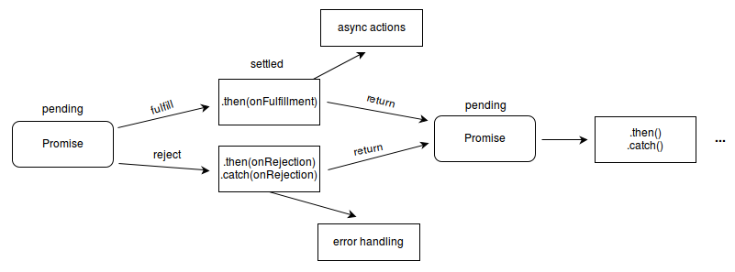
JS Promises
A Promise is a proxy for a value not necessarily known when the promise is created.
Notes:
It allows you to associate handlers with an asynchronous action's eventual success value or failure reason. This lets asynchronous methods return values like synchronous methods: instead of immediately returning the final value, the asynchronous method returns a promise to supply the value at some point in the future

Slide 6
JS Promises
A Promise is a proxy for a value not necessarily known when the promise is created.
Usage
Running asynchronous functions
HTTP requests
Accessing storage
Notes:
Usage is basically for expensive things, and things that you don’t know how long they’ll take

Slide 7
Example

Slide 8
JS Promises
A Promise is a proxy for a value not necessarily known when the promise is created.

Slide 9
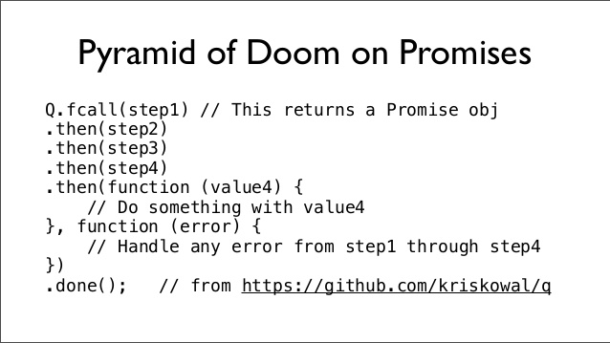

JS Promises - Pyramid of doom

Slide 10

Async/await for the rescue
A way of declaring Asynchronous
functions, and to control blocking
or running asynchronously.
myfunction = () => {
//Code before
promise1.then(function(value) {
console.log(value);
});
//Code after
}
myfunction = async () => {
//Code before
const value = await promise1;
console.log(value);
//Code after
}
Async
Await

Slide 11
Example

Slide 12

Overview for today
Basic JS Promises
Asynchronous Storage and Secure Storage
SQLite local storage
Build a to-do list

Slide 13

Overview for today
Basic JS Promises
Asynchronous Storage and Secure Storage
SQLite local storage
Build a to-do list

Slide 14
AsyncStorage
A simple, unencrypted, asynchronous, persistent, key-value storage system that is global to the app. It should be used instead of LocalStorage.

Slide 15

AsyncStorage
A simple, unencrypted, asynchronous, persistent, key-value storage system that is global to the app. It should be used instead of LocalStorage.
.
.
.
.
.
.
.
Loc : CA
.
.
Age : 20
Loc : CA
Hei : 175
Name : Abd
Fav : World
Wei : 75
User
Places
Person ID

Slide 16
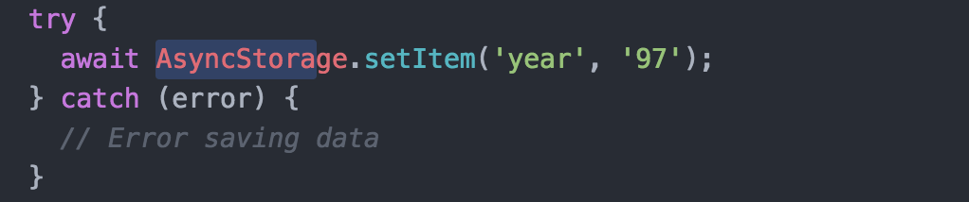
Using AsyncStorage
Pushing Data
.
.
.
Hei : 175
Wei : 75
Person ID

Slide 17
Using AsyncStorage
Pushing Data
year : 97
.
.
.
Hei : 175
Wei : 75
Person ID

Slide 18
Using AsyncStorage
Pushing Data
year : 97
Hei : 175
Wei : 75
Person ID

Slide 19
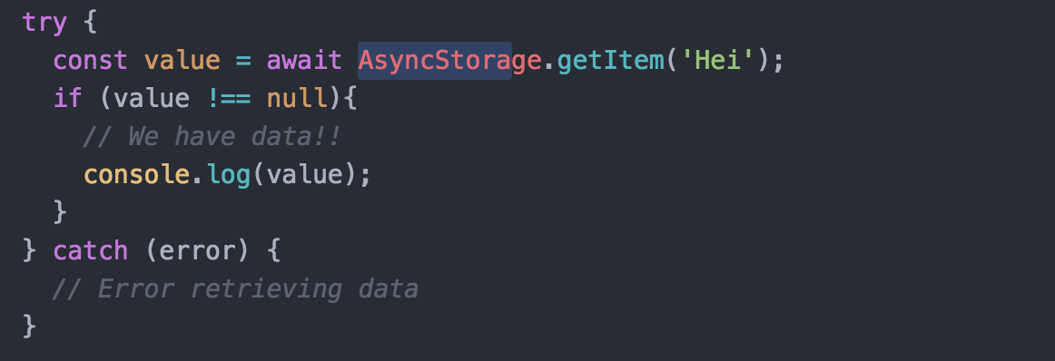
Using AsyncStorage
Pushing Data
Fetching Data
year : 97
Hei : 175
Wei : 75
Person ID

Slide 20
Using AsyncStorage
Pushing Data
Fetching Data
year : 97
‘175’
Hei : 175
Wei : 75
Person ID

Slide 21
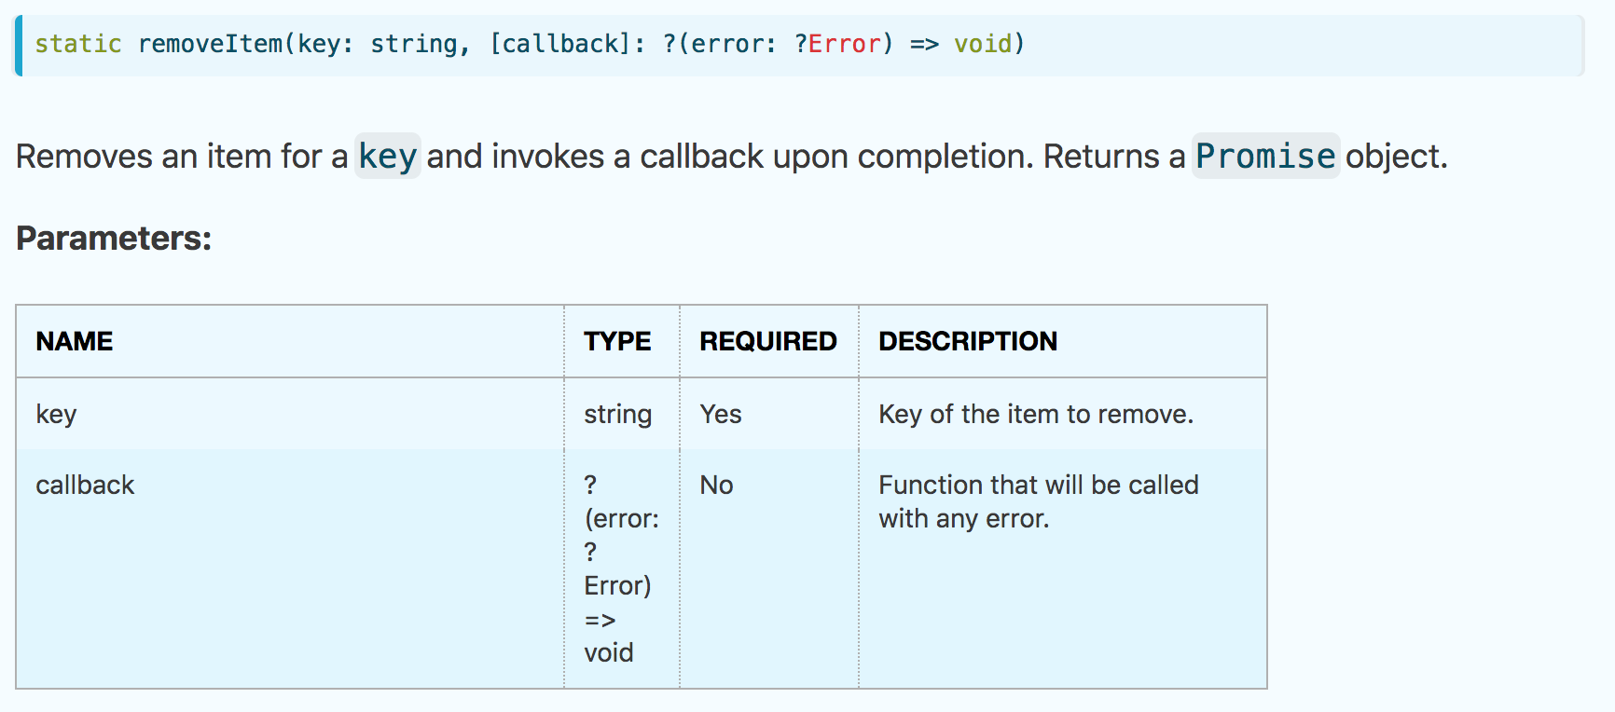
Using AsyncStorage
Pushing Data - AsynchStorage.setItem(key, val)
Fetching Data - AsynchStorage.getItem(key)
Removing Data
year : 97
Hei : 175
Wei : 75
Person ID

Slide 22
Using AsyncStorage
Pushing Data - AsynchStorage.setItem(key, val)
Fetching Data - AsynchStorage.getItem(key)
Removing Data - AsynchStorage.removeItem(key)
Clearing - AsynchStorage.clear()
All keys - AsynchStorage.getAllKeys()

Slide 23
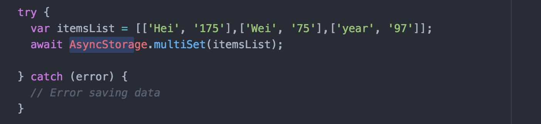
Using AsyncStorage
Multi pushing
Person ID

Slide 24
Using AsyncStorage
Multi pushing
year : 97
Hei : 175
Wei : 75
Person ID

Slide 25
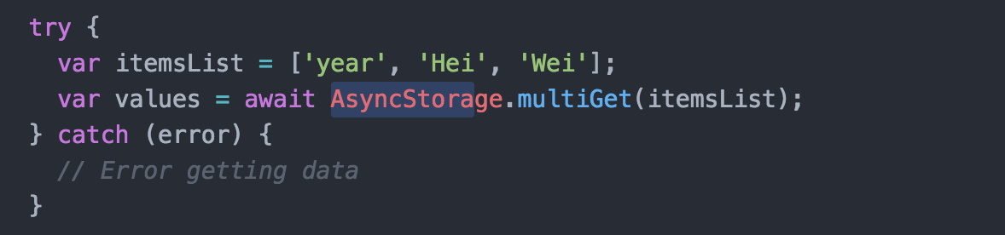
Using AsyncStorage
Multi pushing
Multi getting
year : 97
Hei : 175
Wei : 75
Person ID

Slide 26
Using AsyncStorage
Multi pushing
Multi getting
year : 97
Hei : 175
Wei : 75
[[‘year’,‘97’], [‘Hei’,‘175’], [‘Wei’,‘75’]]
Person ID

Slide 27
Using AsyncStorage
Pushing Data - AsyncStorage.setItem(key, val)
Fetching Data - AsyncStorage.getItem(key)
Removing Data - AsyncStorage.removeItem(key)
Clearing - AsyncStorage.clear()
All keys - AsyncStorage.getAllKeys()
Multi pushing - AsyncStorage.multiSet(array<array<string>>)
Multi getting - AsyncStorage.multiGet(array<string>)

Slide 28

NOTE
All functions of AsyncStorage are asynchronous (Did that surprise you? :o) Make sure you use async/await with it to get desired result

Slide 29


Secure Storage

Slide 30
SecureStore
Provides a way to encrypt and securely store key–value pairs locally on the device. Each Expo project has a separate storage system and has no access to the storage of other Expo projects.
.
.
.
.
.
.
.
Loc : CA
.
.
Age : 20
Loc : CA
Hei : 175
Age : 20
Loc : CA
Hei : 175
Name : Abd
Fav : World
Wei : 75
Name : Abd
Fav : World
Wei : 75
User
Places
Person ID
User

Slide 31
SecureStore
Provides a way to encrypt and securely store key–value pairs locally on the device. Each Expo project has a separate storage system and has no access to the storage of other Expo projects.
Loc : CA
Age : 20
Loc : CA
Hei : 175
Name : Abd
Fav : World
Wei : 75
User
Places
Peron ID

Slide 32
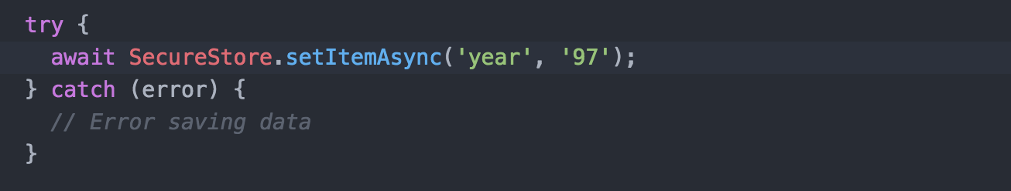
Using SecureStore
Pushing Data

Slide 33
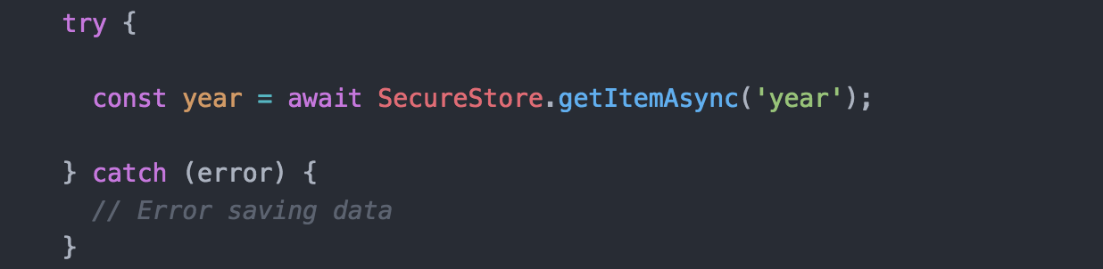
Using SecureStore
Pushing Data
Getting Data

Slide 34
Using SecureStore
Pushing Data - SecureStore.setItemAsync(key, value, options)
Getting Data - SecureStore.getItemAsync(key, value, options)
Deleting Data - SecureStore.deleteItemAsync(key, value, options)
Notes:
No multis/collective data actions

Slide 35
Live Demo
AsyncStorage and SecureStore
Notes:
No multis/collective data actions

Slide 36
Overview for today
Basic JS Promises
Asynchronous Storage and Secure Storage
SQLite local storage
Build a to-do list

Slide 37
Overview for today
Basic JS Promises
Asynchronous Storage and Secure Storage
SQLite local storage
Build a to-do list

Slide 38
SQLite
An Expo module that gives you access to a locally stored database. The database persists across restarts.
Jedis
Books
ID | Name | Gender | Year | Height | Weigth
1 | Abdallah | Male | 97 | 175 | 75
2 | Santi | Male | 95 | 170 | 78
ID | Title | Color | Author
Person ID

Slide 39
Using SQLite
You will always need to open the database before using it SQLite.openDatabase(name, version, description, size) => DB
Then we use DB to execute transactions db.transaction(callback, error, success)
Transactions are objects that have a function called “executeSql” tx.executeSql(sqlStatement, arguments, success, error)

Slide 40
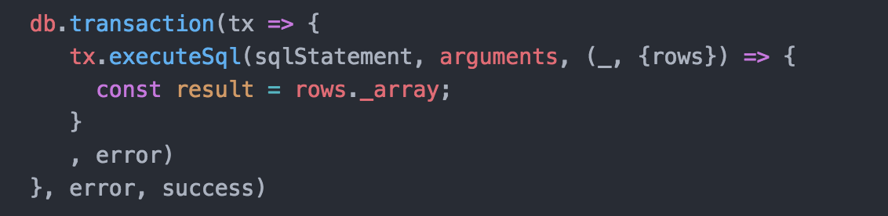
Typical Use of SQLite
Used at the top var db = SQLite.openDatabase(name);
Then to execute SQL queries:

Slide 41
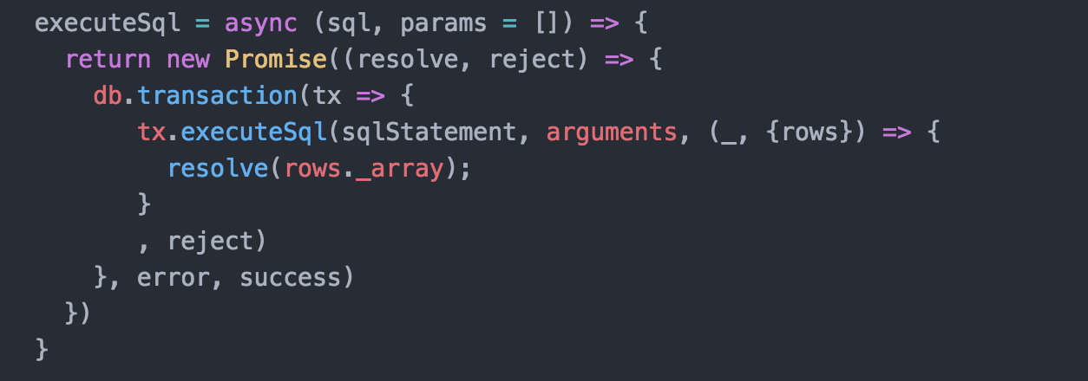
Async/await and promises for the rescue
You can write an asynchronous function to handle all of your querying. On calling it, just use await.

Slide 42
Common SQL Queries
CREATE TABLE [if not exists] table_name (
column1 datatype,
column2 datatype,
column3 datatype,
....
);
select column1, column3 from table_name;
insert into table_name (col1, col2) values (‘x’, ‘y’);
delete from locations WHERE col1 = ‘x’
https://www.w3schools.com/sql/default.asp

Slide 43
SQLite code analysis

Slide 44

Overview for today
Basic JS Promises
Asynchronous Storage and Secure Storage
SQLite local storage
Build a to-do list
YOU

Slide 45
Overview for today
Basic JS Promises
Asynchronous Storage and Secure Storage
SQLite local storage
Build a to-do list
YOU

